Slide 1
Computer Architecture
The mainboard

Slide 2
Lecture Objectives
Introduction to the Arduino Uno and development equipment
Preparation for the lab activities

Slide 3
Address BUS
CPU
RAM
ROM
I/O
Data BUS
Control BUS

Slide 4
Development Equipment
Mainboard
Arduino Uno & PC USB cable
Integrated Development Environment
Allows you to write and upload programs
Note that this is only available in W201
Breadboard
Allows components to be wired to the Arduino

Slide 5
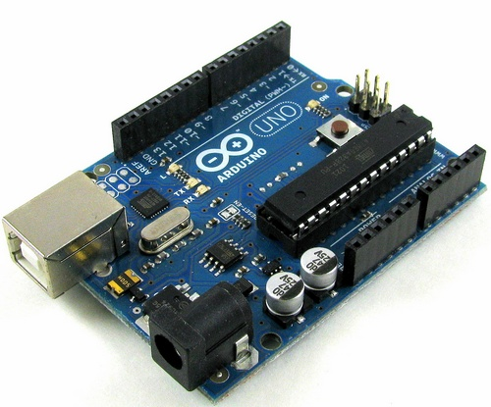
The Mainboard:
Arduino Uno

Slide 6
Arduino Uno I/O
to PC
We won’t be using analog pins

Slide 7
Atmel ATMega328 Processor
CPU – 8-bit Atmel AVR (16MHz)
FLASH – 32kBytes
RAM – 2kBytes
EEPROM – 1kBytes
Input Output
Analog/Digital
PWM
Comms - Serial, I2C, SPI

Slide 8
Development Platform
Arduino has no operating system.
Initialises it’s hardware via it’s BIOS.
No direct user interaction.
Requires a development platform.
The development platform exists on a PC.

Slide 9
Integrated Development Environment
We need a PC based IDE to interact with Arduino
This allows us to:
Write the software
Compile it into a binary image
Upload this to the Arduino
This is programmed into FLASH memory
Once done, it can operate independently

Slide 10
Breadboards
To wire components together easily
Consist of pin sockets hardwired in rows

Slide 11
Breadboards
To wire components together easily
Consist of pin sockets hardwired in rows

Slide 12
Traffic Lights

Slide 13
Breadboards – Traffic Lights

Slide 14
Arduino IDE
Connect to PC using USB cable
Launch the IDE:
Path:
All programs
Computing
Arduino
arduino

Slide 15
1. Configure IDE
Select Board
Select Serial Port
Comport will be SECOND port in list
If only 1 appears:
close down IDE
plug in Arduino
Try again

Slide 16
2. Write Code, or….

Slide 17
3. Load Example

Slide 18
3a. Blink Example

Slide 19
4. Upload to Arduino

Slide 20
Lab activity 1 - Familiarisation
Obtain an Arduino dev. kit from the helpdesk
you will need your student card to sign it out
Upload the blink example
This flashes the on-board LED
Connect a single LED to pin 13 and GND
Using the PhysicalPixel example, modify your code so that you can turn the LED on and off from the computer keyboard.

Slide 21
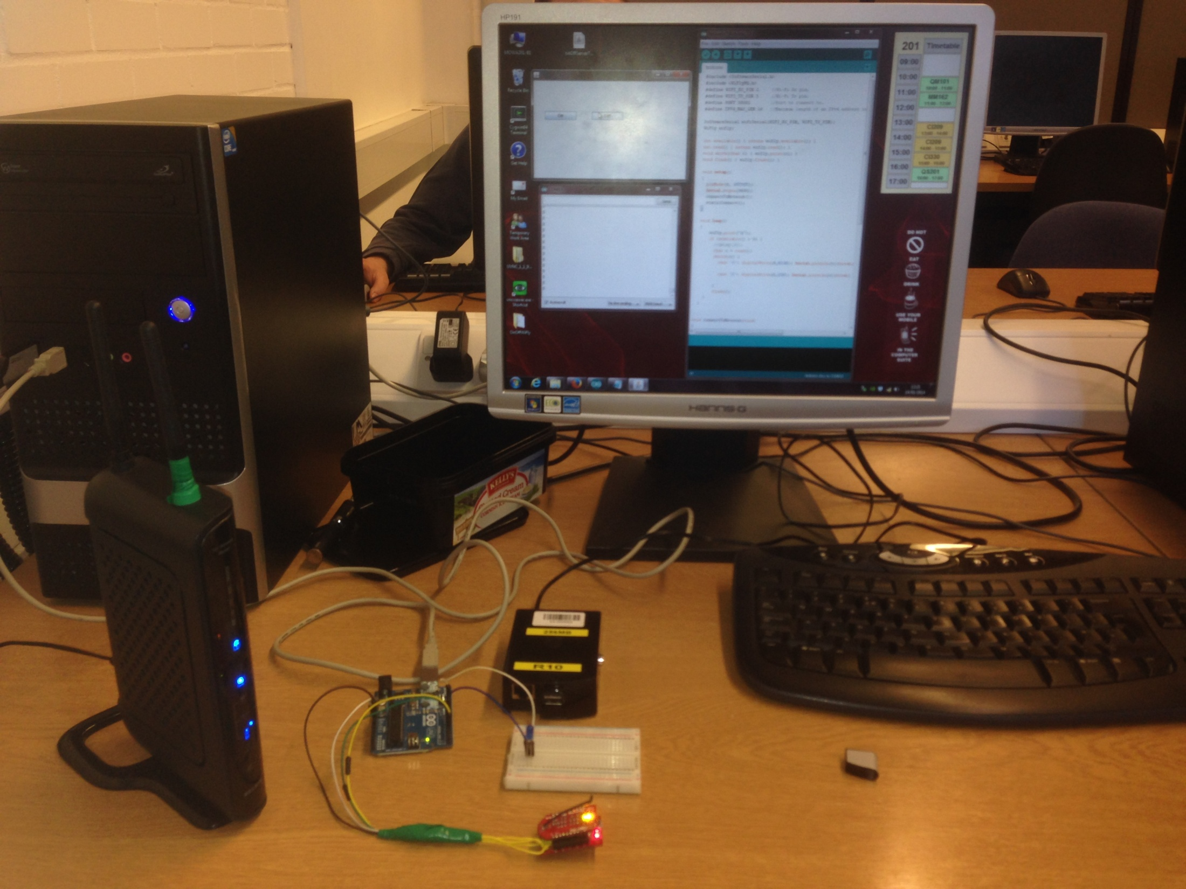
Putting it all
Together…

Slide 22
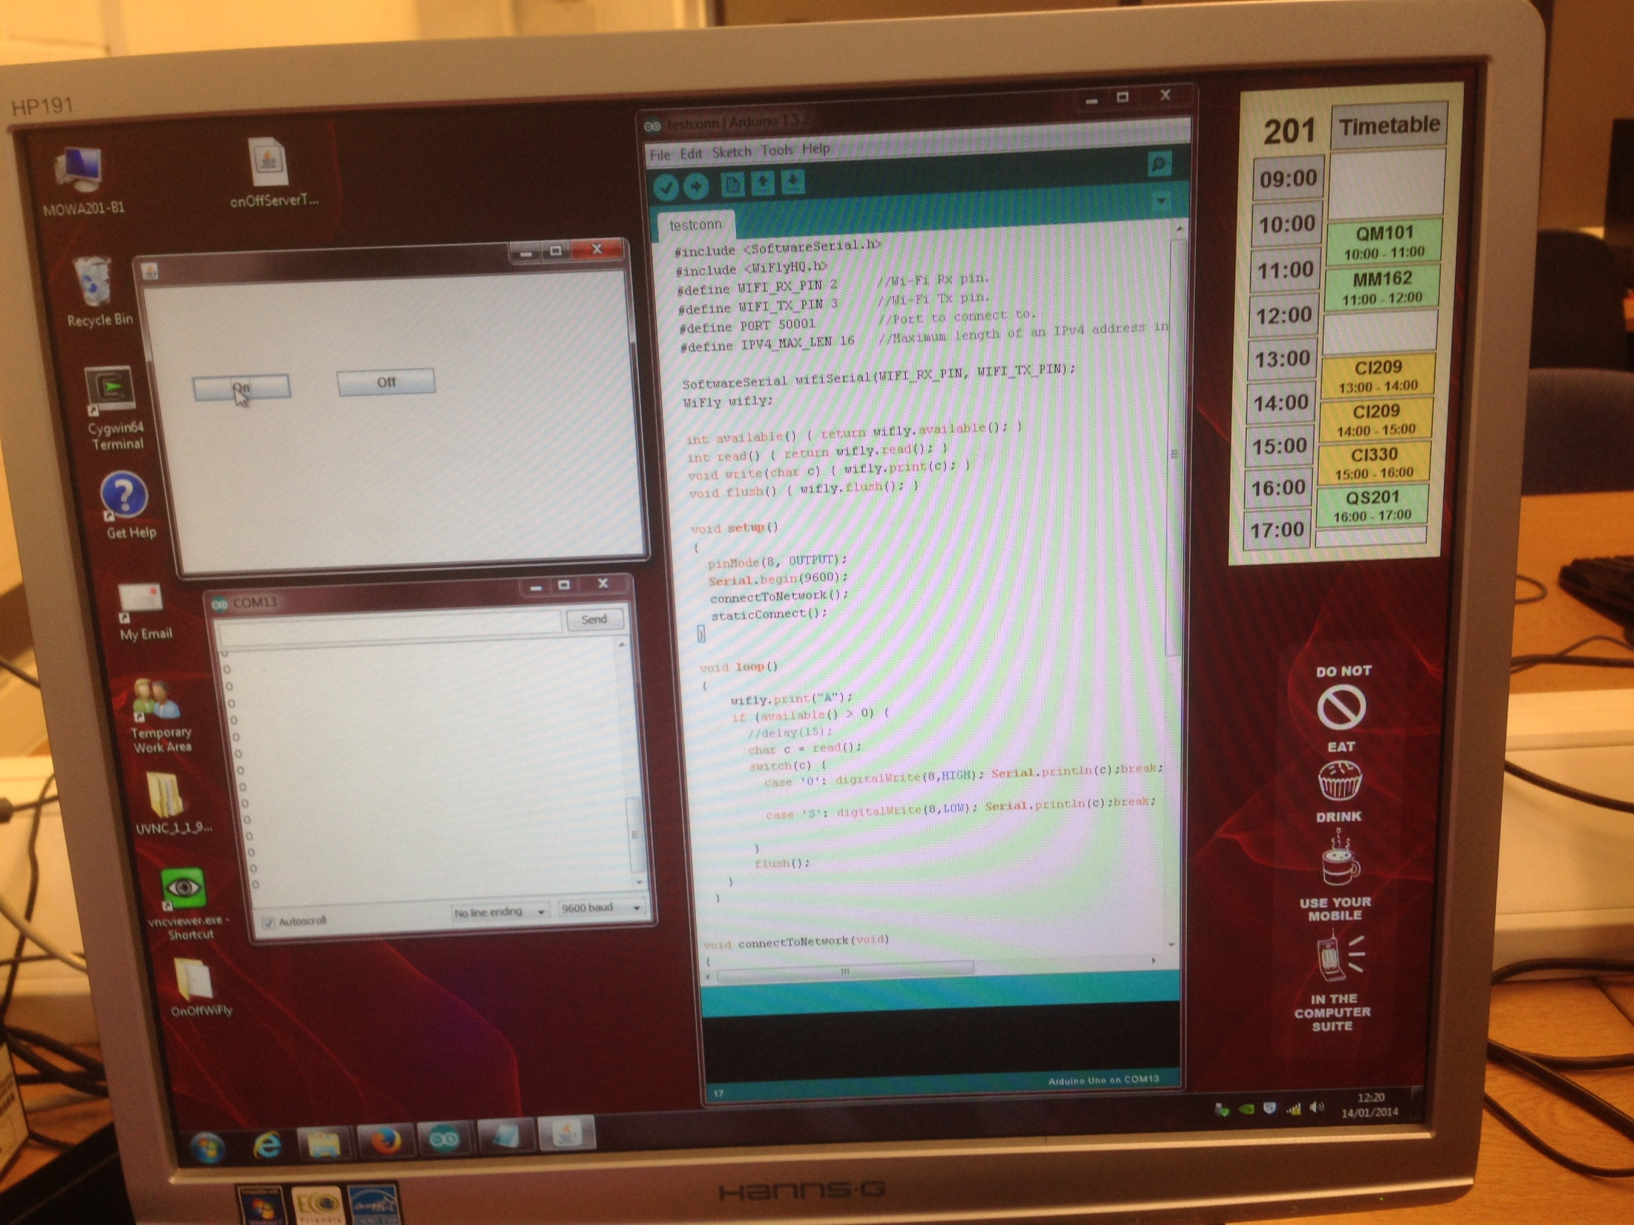

Slide 23
